Slide 1

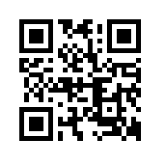
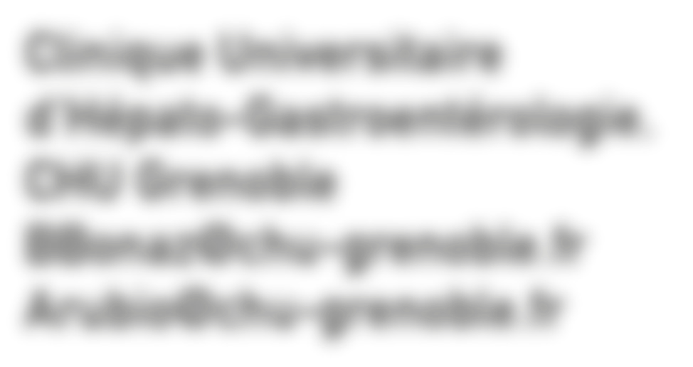
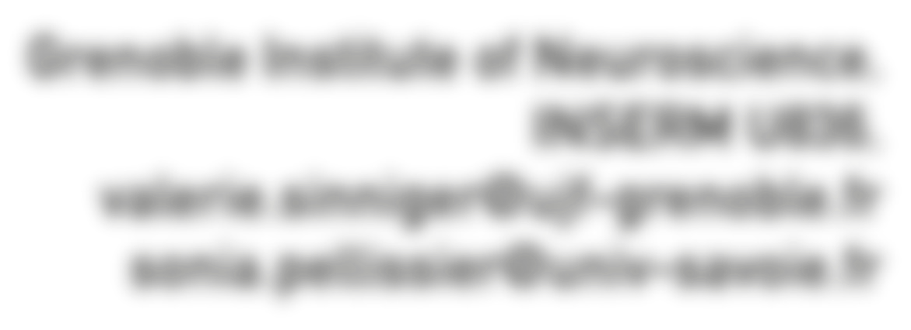
Summer School on Stress
From Hans Selye’s original concept to recent advances
29 June - 2 July 2015, Grenoble, France
Organized by Selye International Institute for Advanced Studies,
IUPHAR GI Section & University of California- Irvine Sch. of Medicine
SIIAS: szs@selyeinstitute.org
Clinique Universitaire d'Hépato-Gastroentérologie, CHU Grenoble
BBonaz@chu-grenoble.fr Arubio@chu-grenoble.fr
Grenoble Institute of Neuroscience,
INSERM U836,
valerie.sinniger@ujf-grenoble.fr sonia.pellissier@univ-savoie.fr
www.stresseducation.org

